Slide 1
Determining the best location to Open a Pet Store in Orlando, Florida

Slide 2
Introduction
Business Problem
In this project, the goal was to find an optimal location for a Pet Store. This report will be especially useful to entrepreneurs interested in opening a pet store in Orlando, Florida.
There were many competing pet stores in the State of Florida. Therefore, I tried to detect locations that were not already crowded with pet stores, specifically around Orlando. I was also particularly interested in areas with dog-runs/parks but few pet stores in the surrounding area. Locations that were as close as possible to the city center were preferable, only if the previous two conditions were met.
In this project I generated a few of the most promising neighborhoods based on the established criteria.

Slide 3
Data
Considering the established problem, some of the factors I considered in decision-making were:
The number of existing dog parks in the neighborhood, regardless of the rating on Foursquare.
If any, the number of, and distance to each of the pet stores in the neighborhood.
The distance of each neighborhood from Orlando’s city center.
The data sources that were needed were:
Google Maps API
The coordinates of Orlando City center were obtained through the Google Maps API geocoding.
Foursquare API to get the location and number of pet stores, dog parks in every neighborhood.

Slide 4
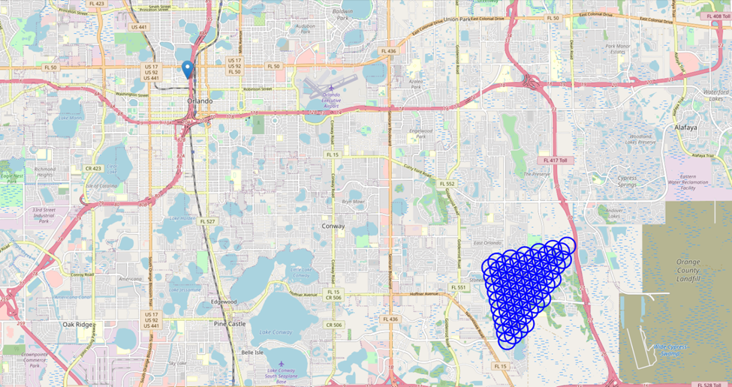
Creating Potential/Prospective Neighborhoods:
Figure 1: Visualized the data obtained so far: city center location and candidate neighborhood centers:

Slide 5
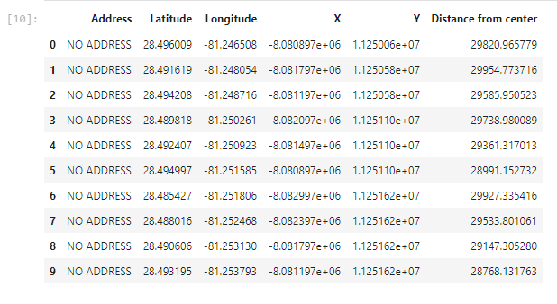
Geographic Coordinates
Figure 2: Location Addresses of Orlando, Florida and their respective distances from the City Centre (Orlando Centroplex) saved this data into a local file

Slide 6
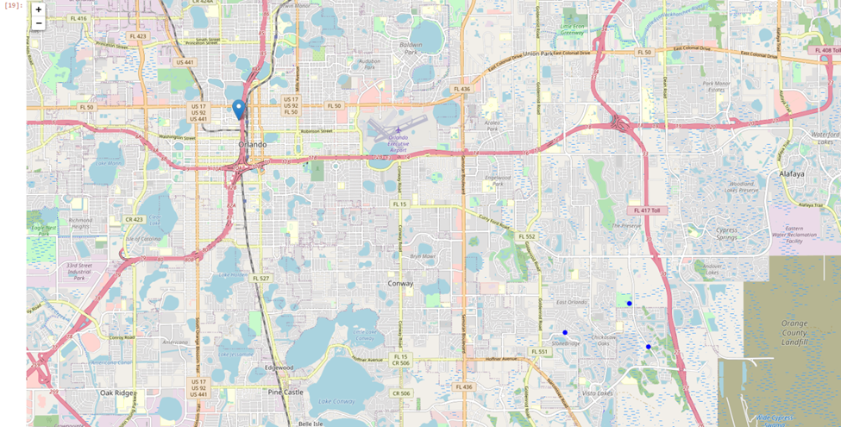
Foursquare API:
I was interested in venues in 'dog run' and 'pet store' categories. I included in a list only venues that had 'dog run' in category name and made sure to detect and include all of the 2nd category of specifically 'pet store', as I needed the information on pet stores in the neighborhood.
Figure 3: All the dog runs/parks in this area of interest on map, and also show Pet Stores in different color.

Slide 7
Methodology
For this project the focus was detecting areas around Orlando that have low density of pet stores especially these adjacent to dog runs/parks. The analysis was limited to area 30km around a selected central point, Orlando Centroplex in the city center of Orlando, Florida.
In the previous step I had collected the required location data consisting of every pet store within a 30km radius of the selected central point. Moreover, also identified every park categorized by Foursquare as Dog Run within the same radius.
The next step was the calculation and exploration of 'Dog Park density' across different areas of Orlando, then using heatmaps I identified a few promising areas close to center with high number of dog runs/parks in general as well as no pet stores in vicinity and focus on those areas.
In the last step I focused on the most promising areas and within those create clusters of locations that meet the requirements that have been established. I took into consideration locations with no more than two pet stores in radius of 250 meters. I wanted locations without Pet stores in radius of 400 meters and presented map of all such locations and also created clusters, using k-means clustering. Of those locations general locations were identified to be taken into consideration when searching for the optimal place to set up shop.

Slide 8
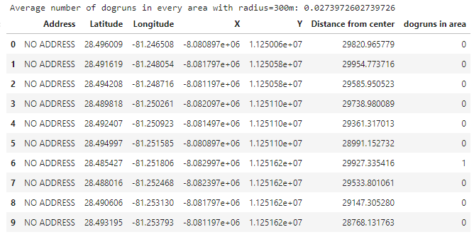
Analysis
I performed some basic explanatory data analysis and derive some additional information from our raw data.
Figure 4: Table showing the number of dog-runs in every prospective area.

Slide 9
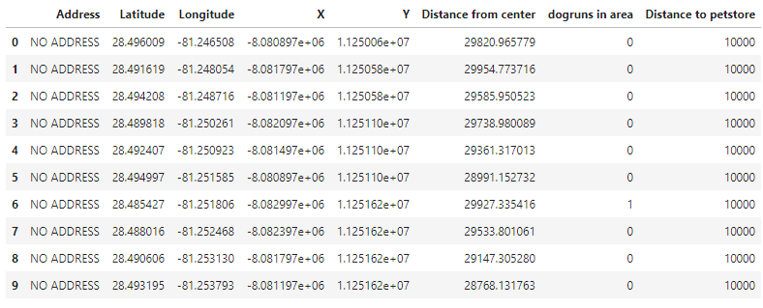
The next item was to calculate the distance to nearest Pet Store from the center of every prospective area/location; not only just those that were within the 300m radius, but I wanted the distance to the closest one, regardless of distance.
Figure 5: Minimum distance to pet store was set to 10000m.

Slide 10
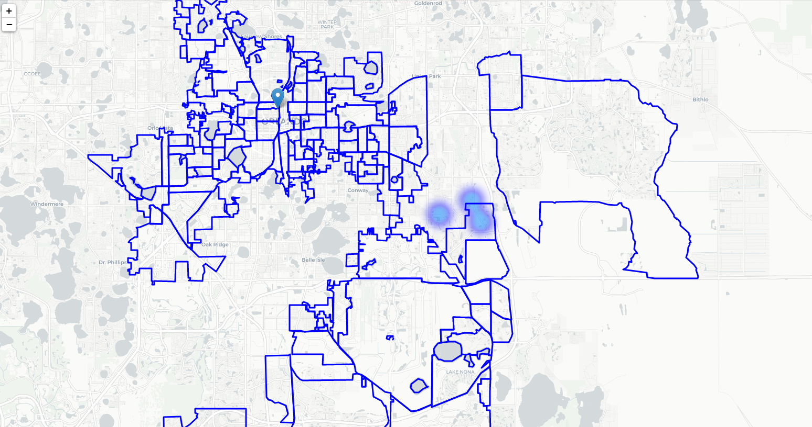
Figure 6: A map showing heatmap / density of dog-runs and try to extract some meaningful information from that. Showing borders of Orlando neighborhoods on the map and a few circles indicating distance of 1km, 2km and 3km from Orlando Centroplex.

Slide 11
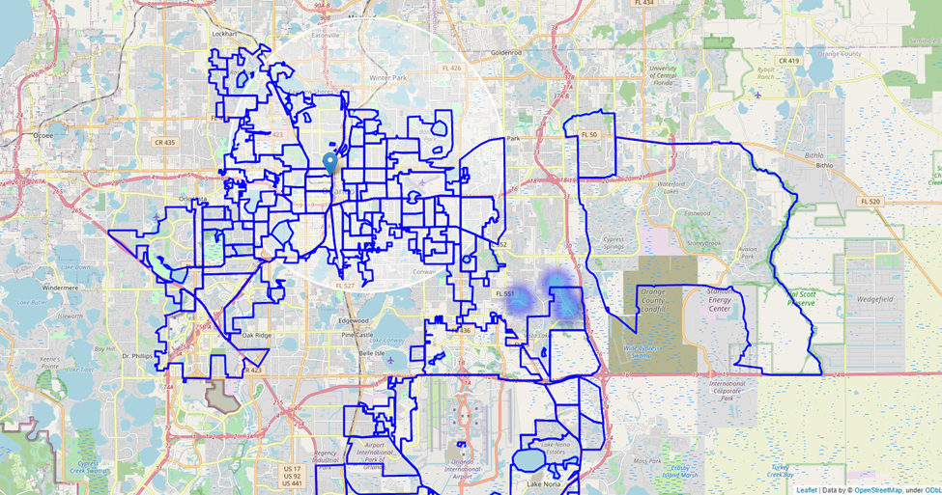
Defining a narrower region of interest.
Figure 7: The pockets of low dog run density closest to the Orlando City Center.

Slide 12
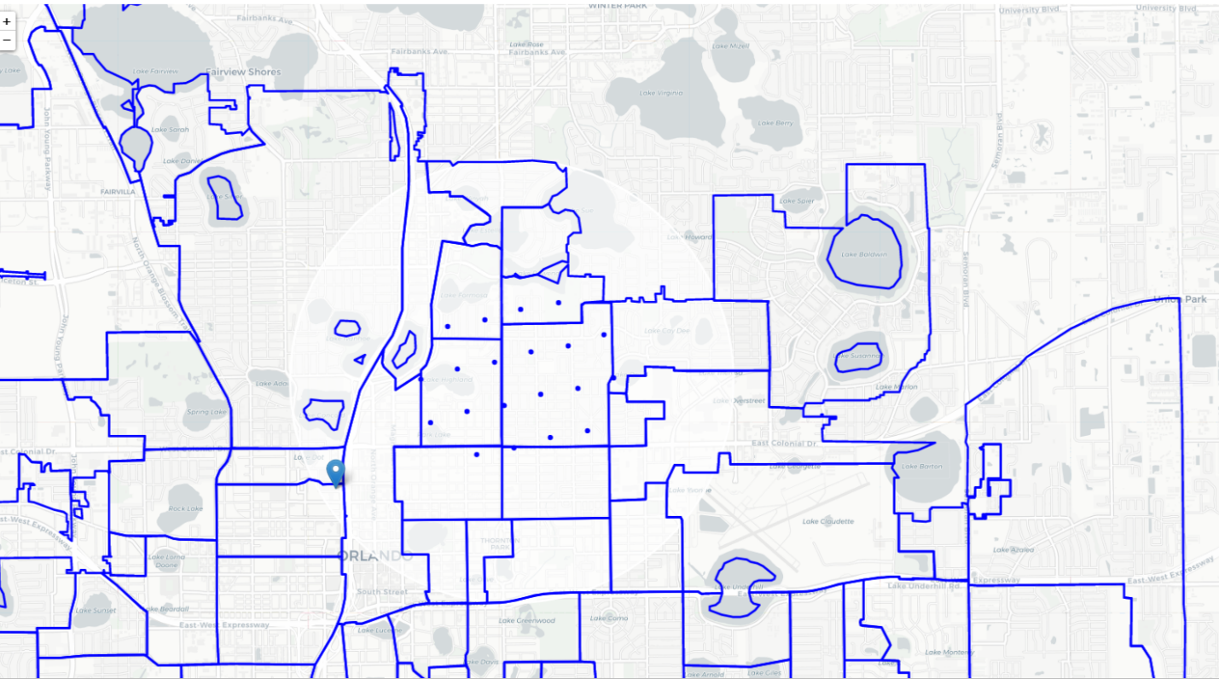
Calculated two most important things for each location candidate: number of dog-runs in vicinity (we'll use radius of 2500 meters) and distance to closest pet store.
Figure 8: Filtered locations. The interest was in locations with no more than two dog runs in radius of 2500 meters, and no pet stores in radius of 4000 meters.

Slide 13
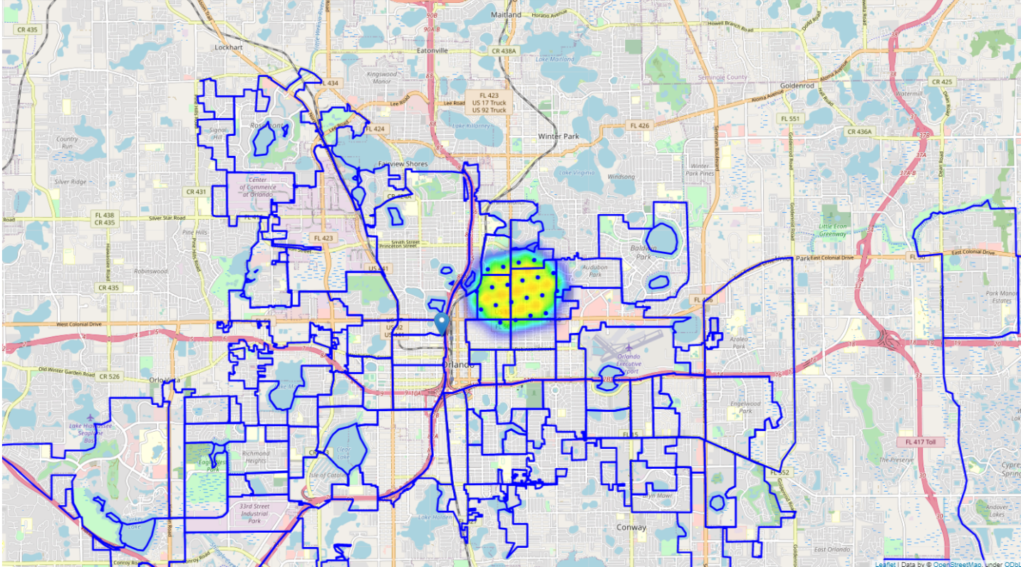
Figure 9: Next, was showing those 'good' locations on a heatmap.

Slide 14
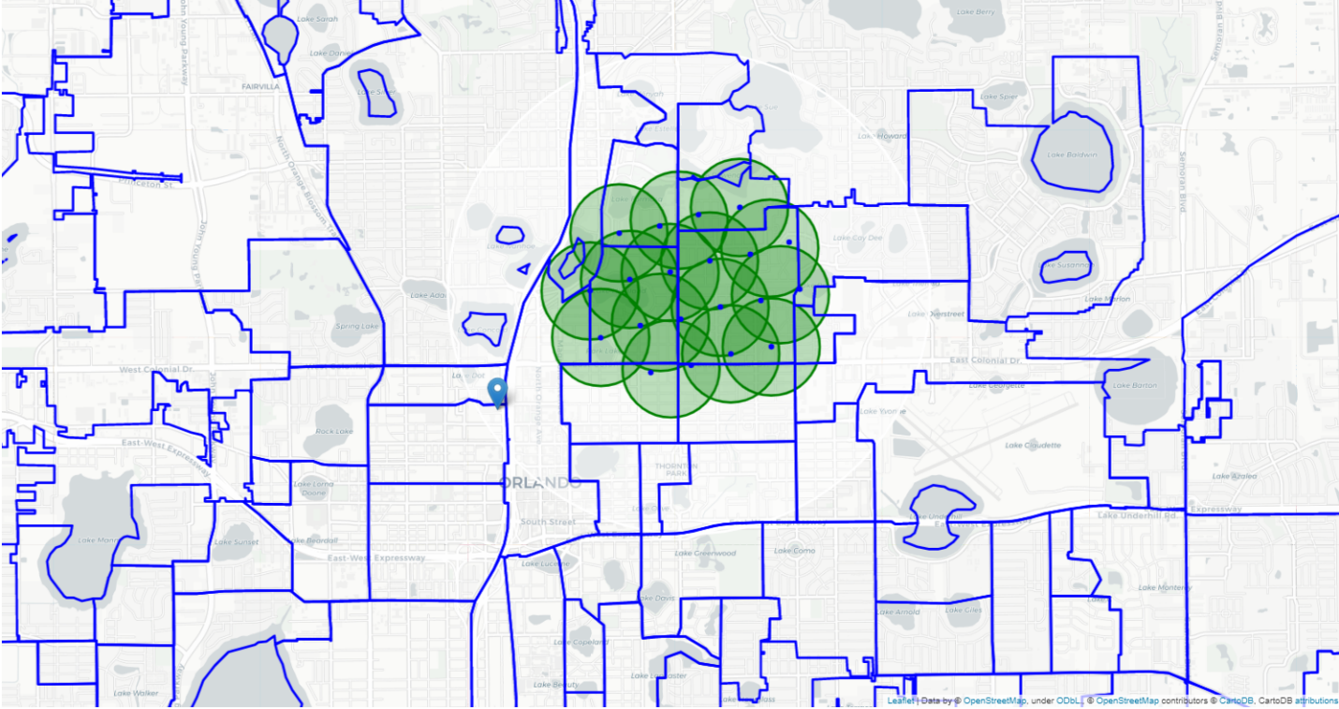
Figure 10: The locations of the centers of these clusters will be a good starting point for exploring the neighborhoods to find the best possible location based on the specifics of each neighborhood.

Slide 15
Results and Discussion
The final result of this project was the identification of 15 zones containing largest number of potential new business locations based on number of and distance to existing venues - both business establishments in general and Pet stores in particular. This project does not conclude or imply that the identified zones were the most optimal for a new Pet Store. However, the purpose of the concluded analysis was simply to provide information concerning areas that were close to the Orlando city center area, that were not overrun by existing business establishments, specifically Pet Stores. Therefore, the areas/zones that have been identified (or recommended) should only be considered starting points for more detailed analysis which should culminate in the selection of a location far from competition, strategically located to reach potential customers among other stakeholder-specific requirements.

Slide 16
Conclusion
The purpose of this project was to identify areas close to Orlando City Center with low number of stores, particularly Pet Stores. This was in order to help entrepreneurs/stakeholders to narrow down their search for the optimal locations for new Pet Stores. By calculating the density and distribution of dog runs/parks from Foursquare data, I have first identified general neighborhoods that justify further analysis based on proximity to customers. I then generated extensive collection of locations which satisfied a simple requirement regarding existing nearby pet stores. Clustering of these locations was subsequently performed in order to identify and create the major zones of interest in the map. These clustered locations contained the greatest number of prospective locations. The final decision concerning the optimal location for a new Pet store will be made by the concerned entrepreneur/stakeholder, based on the specific characteristics of neighborhoods and locations in every recommended zone, taking into consideration additional factors like attractiveness of each location (proximity to dog runs/parks, etc.), pollution levels, and other socio-economic aspects of every neighborhood.

